Slide 1
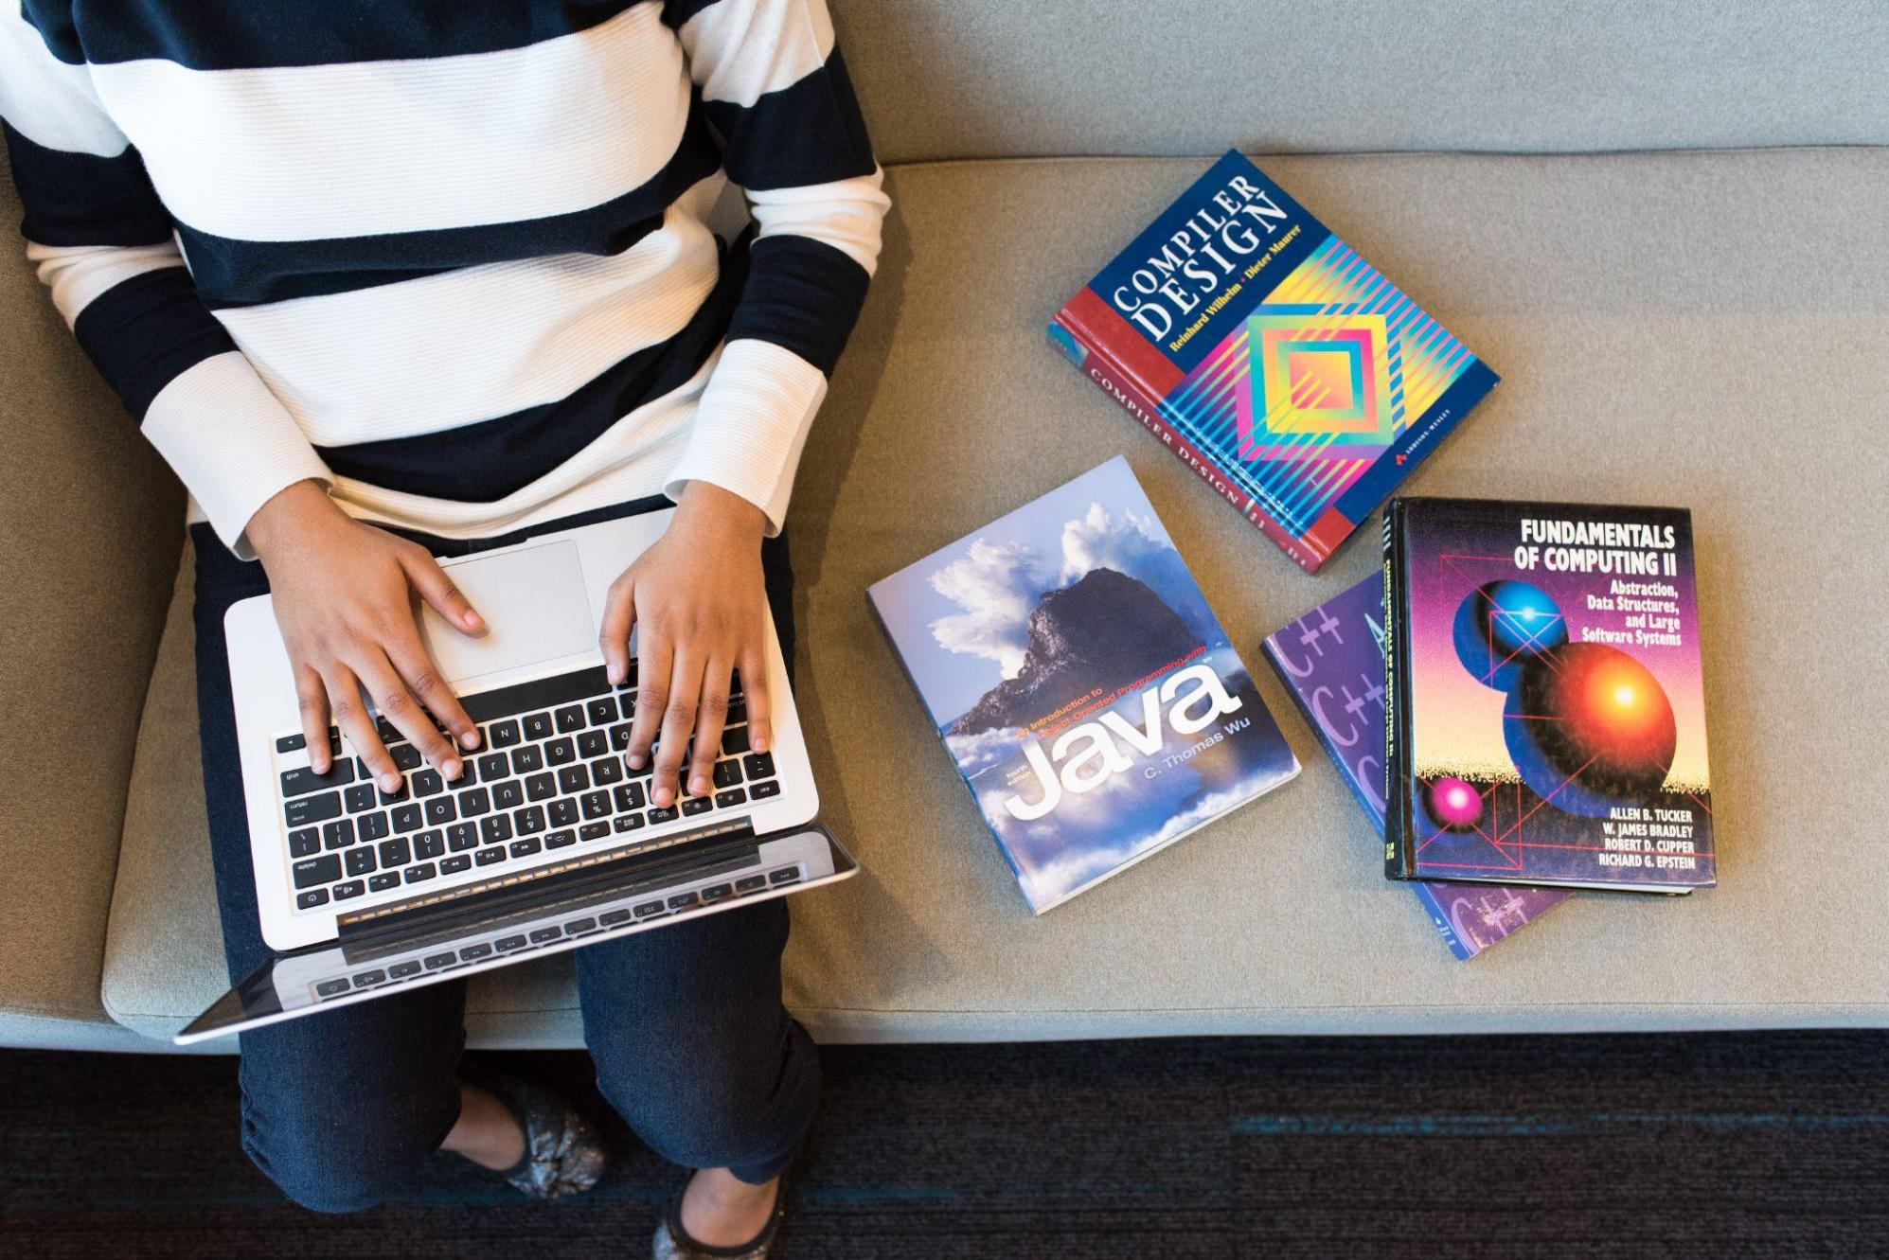
Embedded Ethics: Privacy and Contact Tracing (Module 1)
Notes:
Script by any educator:
Instructor introduces everyone and speaks about the module’s objectives.
Our goal for this module is to give you the tools to recognize, think about, and discuss the ethical issues that emerge out of new technologies. These modules are embedded into your regular classes rather than being freestanding class because we want to show you how these ethical issues emerge out of the concepts you're learning. Understanding these ethical issues can critical to good programming and good product design, as any of the technical skills that you are learning in this class. So, it's not a separate thing, it's related to in part of what you're doing in these classes. Today we're going to discuss phone apps that can be designed to help halt the spread of COVID-19, and some of the trade offs that may have to be made between public health and privacy in the use of these apps.
Licensed by the University of Toronto Embedded Ethics Education Initiative and Steve Engels, under the Attribution-NonCommercial-ShareAlike 4.0 International license. To view a copy of this license, visit https://creativecommons.org/licenses/by-nc-sa/4.0/.
Photo by Christina Morillo from Pexels (https://www.pexels.com/photo/person-using-macbook-pro-on-person-s-lap-1181298/)

Slide 2
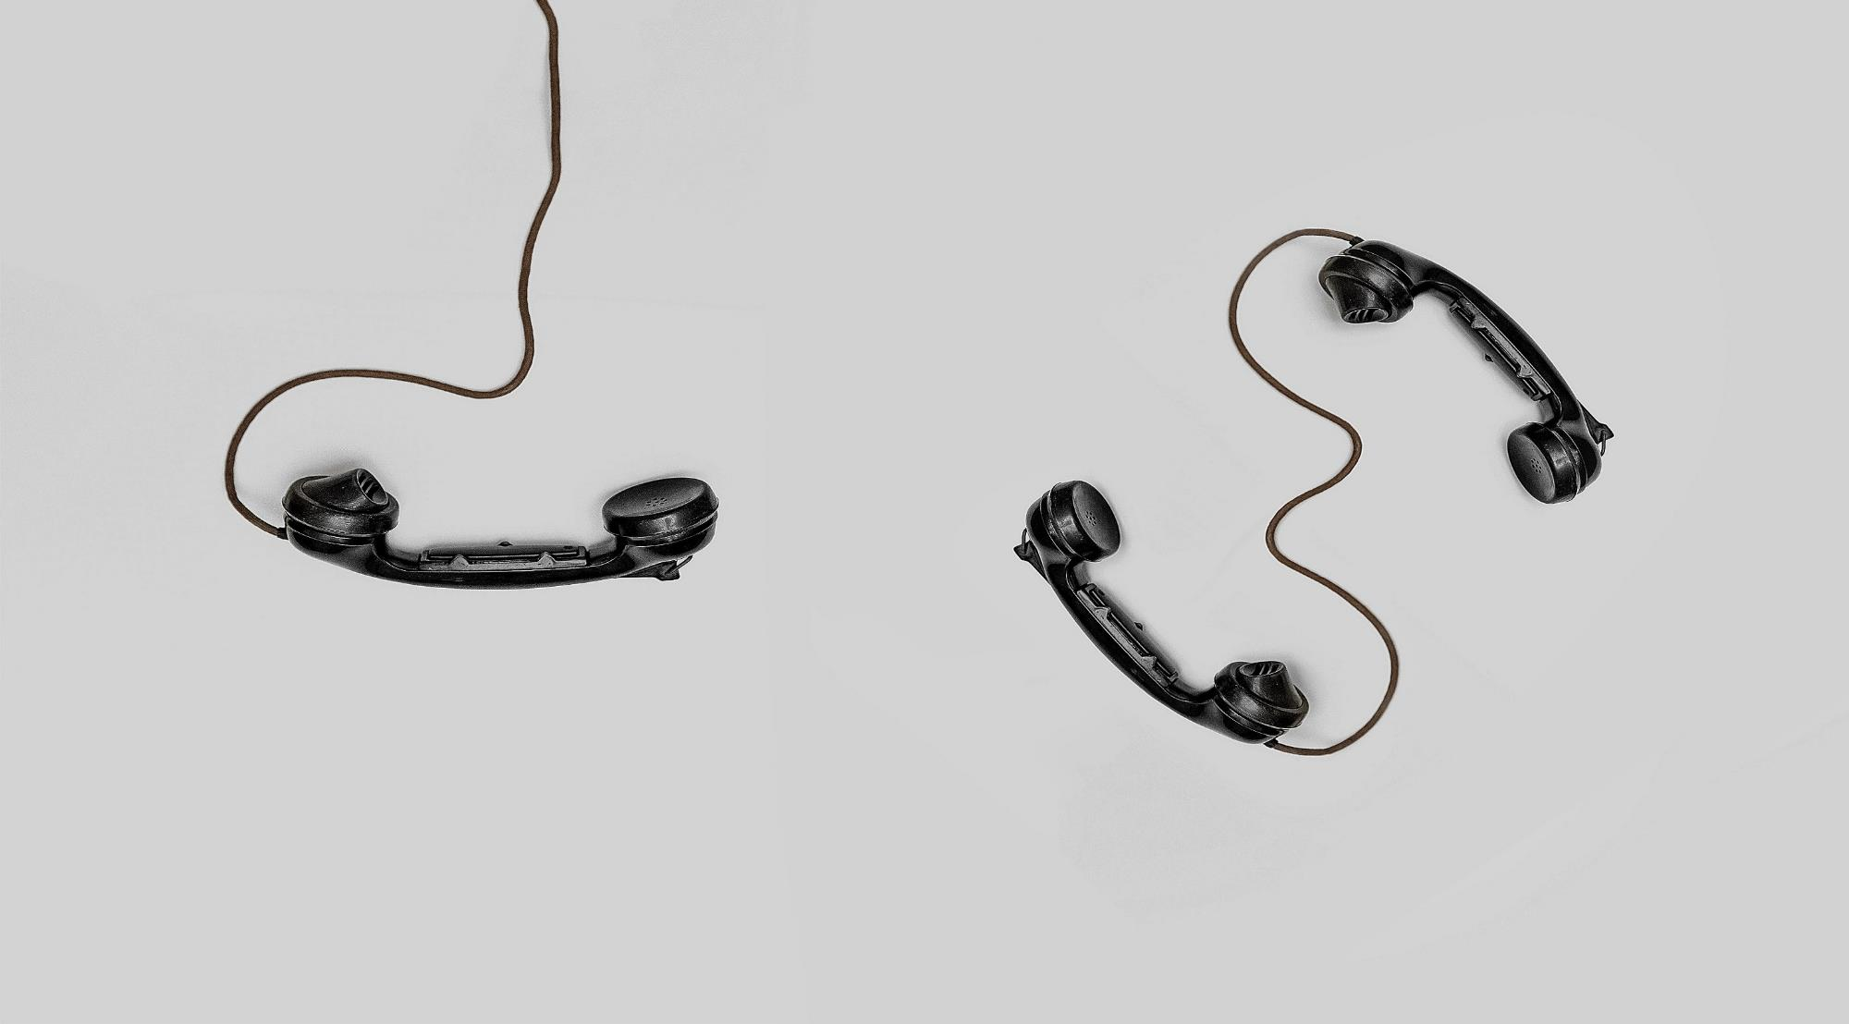
“Contact tracing is the process of identifying, assessing, and managing people who have been exposed to a disease to prevent onward transmission.”
Notes:
Script by the CS educator:
Hi everyone, I have a question for you. Have you heard about covid 19? I want you to use the reactions on zoom or the chat to show me how you feel about covid. Please be gentle! As you can see, COVID 19 concerns us all. One of the approaches for controlling the pandemic is Contact tracing!
The World Health Organization (WHO) describes contact tracing as “the process of identifying, assessing, and managing people who have been exposed to a disease, to prevent onward transmission” [1].
A key task in support of contact tracing is to identify all the people an infected person has come into contact with within a designated period of time.
The specifics of what constitutes a contact and the period of time are disease specific. For covid-19 current best practice requires identifying individuals who may have been exposed to an infected person and following up daily for 14 days from the last point of exposure[2].
As part of our lesson today we discuss a possible design of a digital system that supports contact tracing.
Image Source: Photo by Alex Andrews from Pexels (https://www.pexels.com/photo/three-black-handset-toys-821754/)

Slide 3
X
Y
Node: Person
Edge: Contact
Within two meters (roughly 6 feet) of each other at approximately the same time.
Notes:
Script by the CS educator:
We use a graph structure to capture contact relationships, where each node corresponds to a person, and an edge exists between person X and person Y, if they were within two meters (roughly 6 feet) of each other at approximately the same time for more than a certain period of time.

Slide 4
Marc
Ahmed
Ali
Tiana
Mike
Name | Location | Start Time | End Time
Mike | A | Feb 14th, 9:12 PM | Feb 15th, 1:35 AM
Parsa | A | Feb 14th, 9:37 PM | Feb 15th, 1:15 AM
Tiana | A | Feb 14th, 10:06 PM | Feb 15th, 1:35 AM
Mike | B | Feb 14th, 1:57 AM | Feb 15th, 7:30 AM
Tiana | B | Feb 14th, 1:57 AM | Feb 15th, 9:30 AM
Ahmed | A | Feb 14th, 6:08 PM | Feb 15th, 8:30 AM
Mike | C | Feb 15th, 8:00 AM | Feb 15th, 4:00 PM
Yien | C | Feb 15th, 8:30 AM | Feb 15th, 4:30 PM
Jialun
Mario
Yien
Parsa
Kevin
Bhuvana
Mengsha
Hazel
4
Notes:
Script by the CS educator:
As the system collects data from the users, the corresponding graph is created. Let’s say this graph represents some of the connections that were collected on February 14th from an example data set like this table. Let’s see how it works:
The first column contains the information that individuals are uniquely identified by. For simplicity we refer to it as name. This identifier is represented as the nodes in our graph. The next column, location, shows the place that the person was at, from a start time to an end time, which are captured in the third and forth columns. We show the locations with single letters for simplicity; imagine that these stand for latitude-longitude pairs within a two-meter radius.
Now, let’s complete the graph using this new data set that we have:
First, we see that Mike, Parsa, Tiana and Ahmed have been all in the same loc. A, almost for the same period of time. Therefore, we add the connections between all of them. Then, We see that Mike and Tiana have been in location B from almost 2 am to 7:30 am. The connection is already there from the last record, so we don’t need to add it again. Finally, we see that Mike and Yien were at location C from 8:30 am to 4:30 pm on the next day, February 15th. So, we add the corresponding connection between Mike and Yien as well. Looks like our graph is complete now.

Slide 5
A close contact in the context of covid-19 is defined by the CDC to be “Someone who was within 6 feet of an infected person for a cumulative total of 15 minutes or more over a 24-hour period starting from 2 days before illness onset.”
- Centers for Disease Control and Prevention (CDC)
Marc
Ahmed
Ali
Tiana
Mike
Jialun
Mario
Yien
Confirmed case
Parsa
Close contact
Kevin
Bhuvana
Mengsha
Hazel
Notes:
Script by the CS educator:
OK, lets see how this graph can be used to support contact tracing. According to the Center for Disease Control and Prevention (CDC), a close contact is “Someone who was within 6 feet of an infected person for a cumulative total of 15 minutes or more over a 24-hour period starting from 2 days before illness onset.” Now, if Mike is a confirmed case, according to the CDC definition, his close contacts are Tiana, Ahmed, Parsa and Yien. So, these are the people that must be contacted. So, we see that this system supports our goal for contact tracing.

Slide 6
Empowering our system
How can we make this system more powerful?
Examples?
Ability to prioritize people who are at risk .
Ability to prioritize health care workers.
Provide more in-depth analysis for future research.
…
We need more data!
Age, health profile, vaccination history, etc.
Notes:
Script by the CS educator:
Now I want you to think about how we can make our system more powerful. For example, how about prioritizing people who are at risk?
What do you think? Use the chat or unmute yourself to share your idea.
In-class discussion(Flexible timing) goal: getting students to understand if the system collects more data, the system becomes more powerful Some possible answer.
These are all great ideas.
Maybe ability to prioritize healthcare workers? Or what if we need data to conduct future research or …
Well… we need more data then! Data such as age, healthcare profile, vaccination records, and other demographic information.
Image Source: https://www.rawpixel.com/image/3286284/free-photo-image-lightning-storm

Slide 7
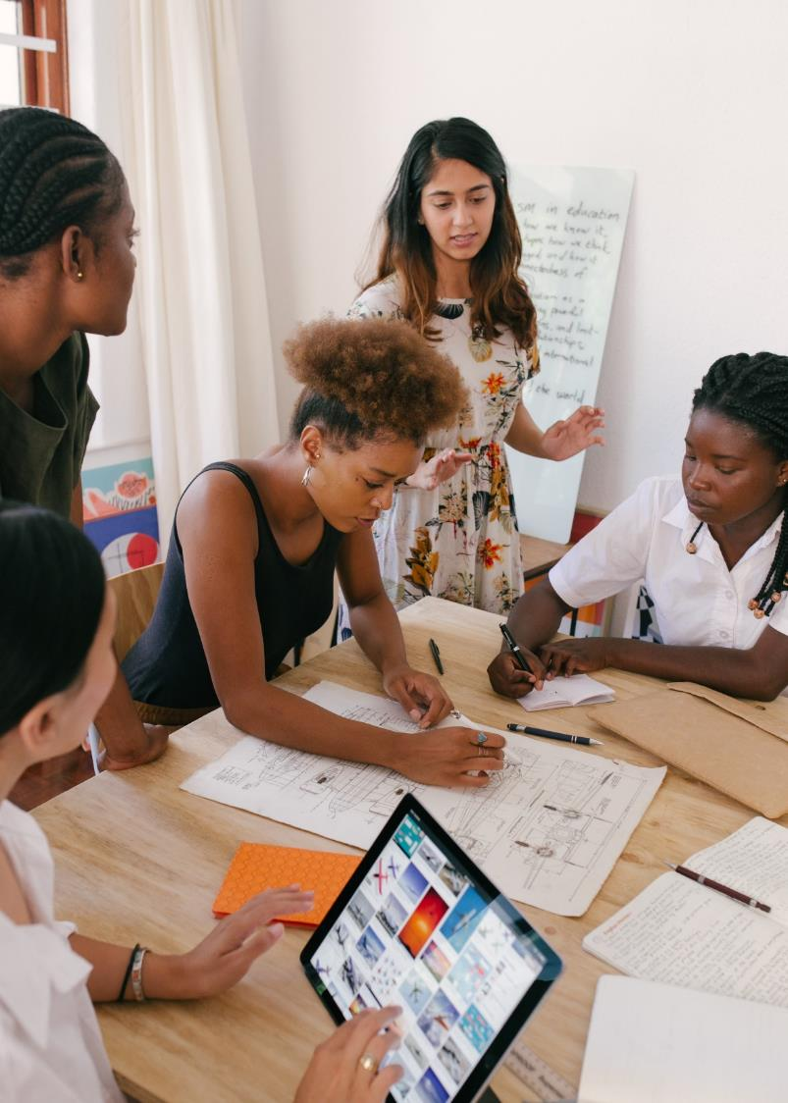
Activity
Find the Contact Tracing worksheet on your Quercus
Get the Contact tracing Worksheet from your Quercus
Review the provided table of data
Answer the questions
Try to make more guesses about our characters
Notes:
Script by the CS educator:
Now let's have a fun activity. I am going to send you to the breakout rooms. You will need your CS worksheet that is available on your Quercus. Please start the activity right away as you have only 6 minutes to finish answering the questions. Remember that for this activity, you don't need to be too precise. It is just about making some rough guesses for answering the questions. Your worksheet contains the same table that we discussed. Make some assumptions about the characters and have fun! We will check on you in the breakout rooms, but if you need help, use the Zoom feature to ask for us.
Image Source: Photo by RF._.studio from Pexels (https://www.pexels.com/photo/photo-of-women-at-the-meeting-3810792/)

Slide 8
Some possible implications
B is Mike’s home
C is Mike’s work
Mike attended a gathering with Ahmed, Tiana, and Parsa
A is Ahmed’s home
Ahmed was the host
B is Tiana's home
Tiana may be Mike's partner
…
Name | Location | Start Time | End Time
Mike | A | Feb 14th, 9:12 PM | Feb 15th, 1:35 AM
Parsa | A | Feb 14th, 9:37 PM | Feb 15th, 1:15 AM
Tiana | A | Feb 14th, 10:06 PM | Feb 15th, 1:35 AM
Mike | B | Feb 14th, 1:57 AM | Feb 15th, 7:30 AM
Tiana | B | Feb 14th, 1:57 AM | Feb 15th, 9:30 AM
Ahmed | A | Feb 14th, 6:08 PM | Feb 15th, 8:30 AM
Mike | C | Feb 15th, 8:00 AM | Feb 15th, 4:00 PM
Yien | C | Feb 15th, 8:30 AM | Feb 15th, 4:30 PM
Given the distance between locations, we might guess how a person commutes
8
Notes:
Script by the CS educator:
I hope you had fun mining our data. OK, can each group share their answers in the chat?
In-class discussion, goal: Leading students to think about the ethical issues that might be raised if the data for a different purpose.
OK, These are all excellent answers. Let’s go over the them briefly. From this sample data, we see that Mike spent his night at location B and his day, which was a Monday, at location C. So, B is probably Mike’ home, and C is his workplace. Then we see that he was with Ahmed, Tiana and Parsa at A, during a Sunday evening. This might have been a friendly gathering. Since Ahmed stayed in the same place for the night, he probably lives at A, so he could be the host. Tiana was in the gathering with Mike and left with him to Mike's house. They are probably partners, and so she lives at B. Did anyone come up with any additional guesses? What did you think about Mike?
By the way, given the distance between locations, we might also guess how these people commutes.
Awesome! So, we see that by possessing individuals’ personal information, a service provider could infer additional knowledge about individuals, beyond the purpose of the intended service. This could include private information which might violate individuals’ privacy—this is an important matter that we want to talk to you about. Now, I hand the discussion over to Benjamin to tell you more about the ethical issues we just introduced.

Slide 9
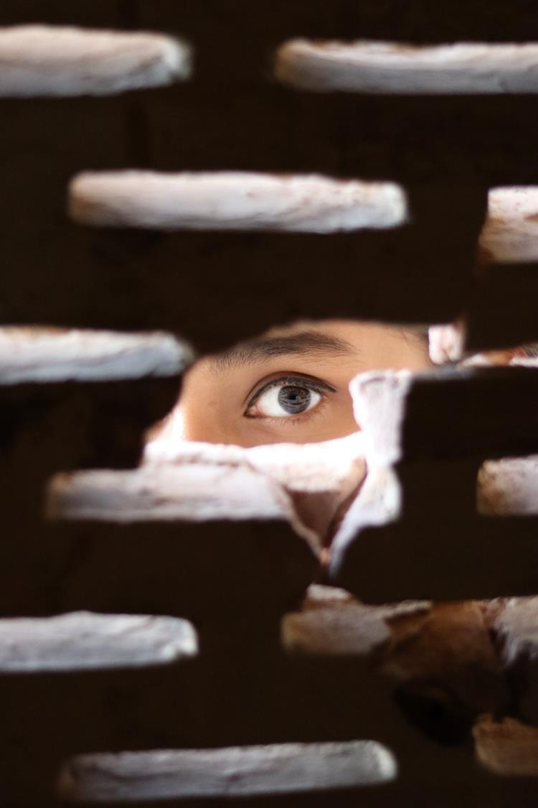
Who Needs Privacy?
Privacy can clearly be valuable for those who have done wrong
But is it true that the innocent have nothing to hide?
Notes:
Script by the Phil educator:
We've seen that even though this is sort of innocuous data we're gathering (with very good purpose to control COVID-19), without any intend to violate people's privacy, (we didn't gather this data in order to figure out personal information), you know who Mike is staying the night with, or anything like that. It turns out that there's a lot we can gather from this data. Whether or not that was the original intention. So, we're violating people’s privacy. You probably heard of concerning stories about privacy violations in the news, such as a data breach where hackers have stolen private information from a company or social media companies collecting information that some people think should remain private. But less often we discuss sort of why privacy is valuable. Why do we care so much about violations of privacy now? One group of people for whom privacy is obviously very valuable are the people who have committed crimes and are afraid of going to jail. OK, fair enough. But we're concerned with the broader range of considerations like privacy, something all of us have a reason to value, and so we're going to see why is it that someone who isn't worried about any sort of criminal activity nonetheless has a reason to value their privacy. So, let's look at a couple of reasons.
Image Source: Photo by Faisal Rahman from Pexels (https://www.pexels.com/photo/photo-of-person-peeking-through-the-hole-3820281/)

Slide 10
Who Needs Privacy?
Sometimes we need privacy to protect ourselves
Ex: Identity theft, but also those fleeing domestic abuse
Notes:
Script by the Phil educator:
So, first of all, it's one of the kind of pretty broad concept. We need privacy to protect ourselves. Now, some of these reasons apply to everyone. For instance, identity theft. Someone who has access to enough private data on you may be able to impersonate you and steal your money, or perhaps take on debt in your name and so on. But some of us have more specific reasons for needing privacy to protect ourselves. People fleeing domestic abuse or abusive relationships often require privacy to protect themselves from the abusive partner, because in many cases the abusive partner is a threat to the safety of the person, once they leave the relationship. So, even though all of us have some reasons, we have to be sensitive to the particular reasons that some individuals have for requiring privacy, perhaps more than others.
Image Source: Photo by Faisal Rahman from Pexels (https://www.pexels.com/photo/photo-of-person-peeking-through-the-hole-3820281/)

Slide 11
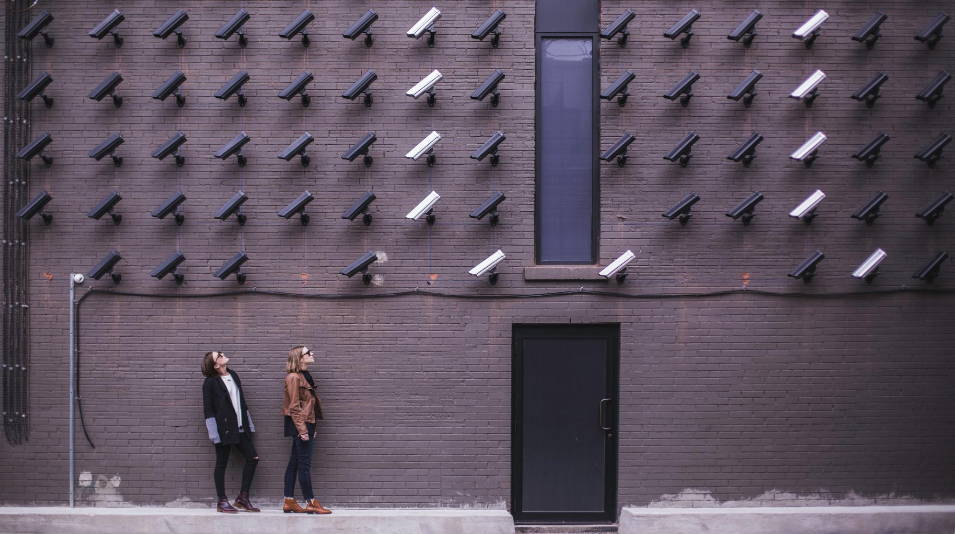
Who Needs Privacy?
We might also worry about the government having access to the information--even if it’s gathered with the best of intentions, it could be misused in the future
And the same is true of private companies having access to the data
Notes:
Script by the Phil educator:
Another concern in general is the worry about the government having access to this information. Even if it's gathered with the best of intentions, it could be misused in the future. Sometimes, people worrying about government can come off as conspiracy theory; such as “they don't actually care about COVID, they just want to track us all with micro chips or something”. But this doesn't need to be the claim. Instead, they worry is that once you have this data, like once it's there, the temptation is always going to use it. The 1984 is a classic example of Totalitarian state that uses the lack of privacy of the citizens to control them. Obviously, the Canadian government isn't in danger of becoming Italian totalitarian state tomorrow, but there's still there is a worry that access to this information could be used to control individuals and to use data in ways that undermine some of the Democratic protections we enjoy. And of course, the data collected not by governments, but by private companies, is not necessarily any better. Many people have similar concerns about private companies having access to our data just for one reason to charge different prices based on information you may not want to reveal. For example, in the airline industry, there's all sorts of ways they use trying to figure out how to charge you the most you can pay and no more. Also, there are examples of people being denied loans on the basis of race or zipcode, if the area code corresponds to a low-income neighborhood. If we don't want companies making decisions like that, then we don't want them having access to that kind of data. So that's another reason we might care about our privacy.
Image Source: https://www.pexels.com/photo/two-person-standing-under-lot-of-bullet-cctv-camera-374103/

Slide 12
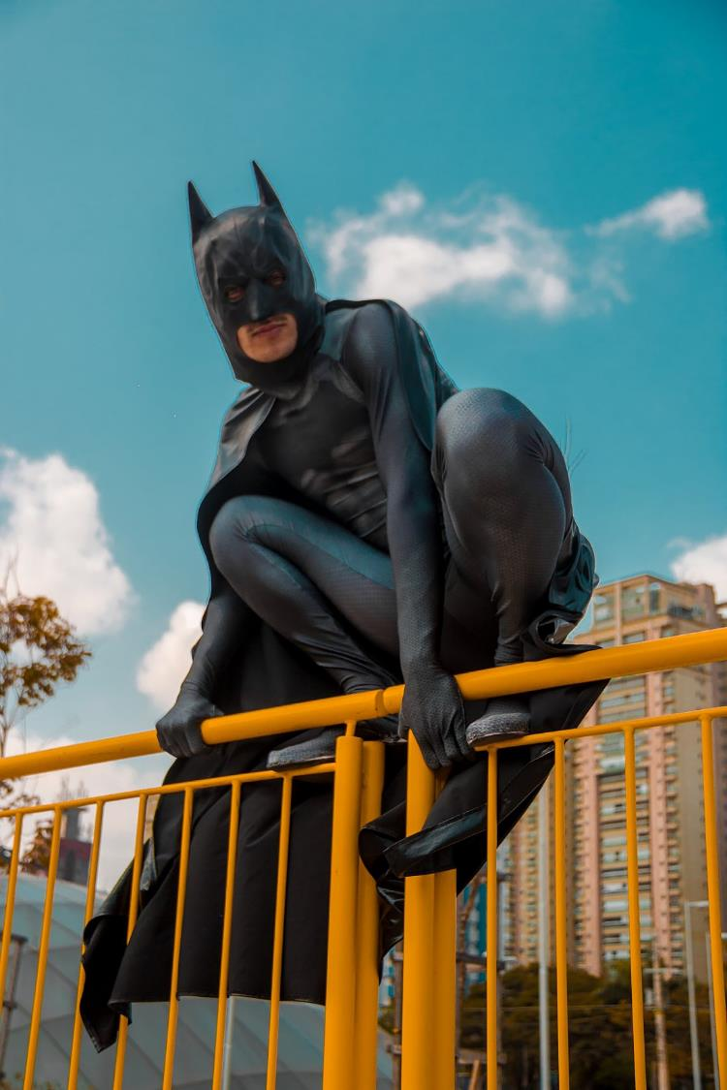
Who Needs Privacy?
Sometimes we need privacy in order to present different faces to different people
Sometimes to avoid discrimination, and sometimes just to maintain boundaries
Notes:
Script by the Phil educator:
And finally, we often need privacy to present different faces to different people. We all have something like secret identities in the sense that we don't reveal everything about ourselves to everyone we meet in the same way. Again, this is something all of us need, but some people have particular reasons for needing it; such as to avoid discrimination. So, if you have, say a mental illness or some sort of disability, or perhaps sexual orientation that may lead to discrimination, you may want to control who knows those facts about yourself, because there might be a stigma associated and you don't want to necessarily deal with that from every individual you meet. But all of us also want to maintain boundaries between different relationships we have. Most of us would tell our friends different things than what we tell our coworkers. There might be some things we only tell our parents and no one else. But they might also be things that we tell a romantic partner that we wouldn't want our parents to know. So, it's not necessarily about closeness, it's about segmenting these relationships and maintaining boundaries. But to do that you need to be able to control who has access to certain kinds of information about you. And that's where privacy comes in: control over who you share different information.
Image Source: Photo by Ronê Ferreira from Pexels (https://www.pexels.com/photo/low-angle-photo-of-man-wearing-batman-costume-2304123/)

Slide 13
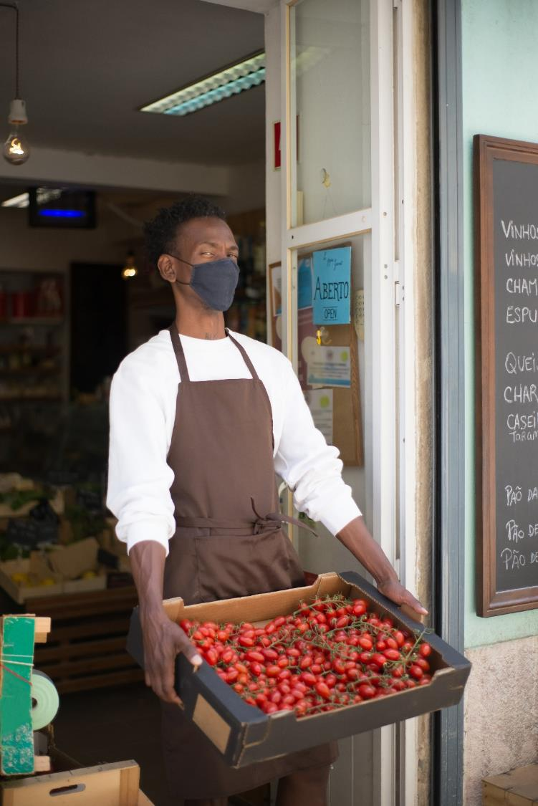
Isaac: A grocery store worker
Isaac is a grocery store worker who has a chronic illness. He worries that if his employer finds out he is high risk, he will be assigned fewer shifts or suffer stigma at work.
Notes:
Script by the Phil educator:
Let's look at a specific case to make this more concrete. Let's consider Isaac, the grocery store worker. He has a chronic illness and worries that if his employer finds out he's high risk for COVID-19, he'll be assigned fewer shifts, and he may suffer stigma at work. Which are the reasons that we've discussed might apply to Isaac?
<In class discussions>
<Optional depending to the discussion>
We might worry that Isaac is prioritizing his own well being over the over public well being. Although, in this case, he's probably the only one who suffers. If he gets COVID, he's not more likely to spread it more than anyone else would be doing the job. He's just more likely to suffer a severe case and maybe be at risk from it. So, his company might use the information against him in particular by assigning him fewer shifts, which affects his livelihood, so he needs privacy for self protection and his economic wellbeing by ensuring continued employment. So, he wants to control who knows these medical facts, such as his private medical data and how others treat him to not be subject to discrimination.
Image Source:
Photo by Kampus Production from Pexels (https://www.pexels.com/photo/a-man-carrying-a-box-of-fresh-tomatoes-8475147/)

Slide 14
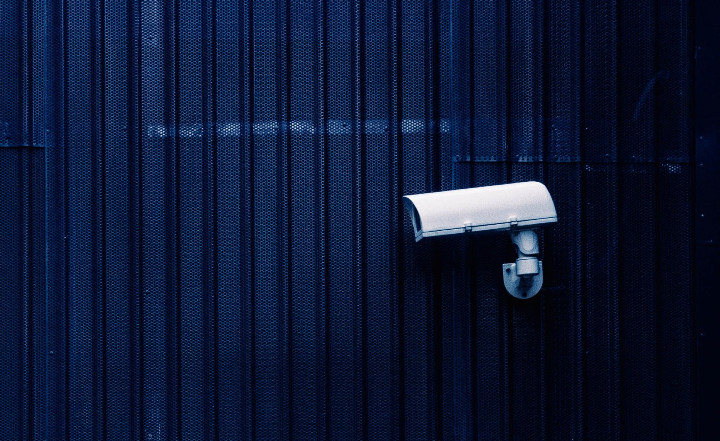
Privacy is all about controlling access to information But some of this same information might help us fight COVID
Notes:
Script by the Phil educator:
So, privacy is all about controlling access to information, but importantly, some of the same information might help us fight covid. So, giving up this information isn't cost free.
Image Source: Photo by Igor Starkov from Pexels (https://www.pexels.com/photo/white-security-camera-776516/)

Slide 15
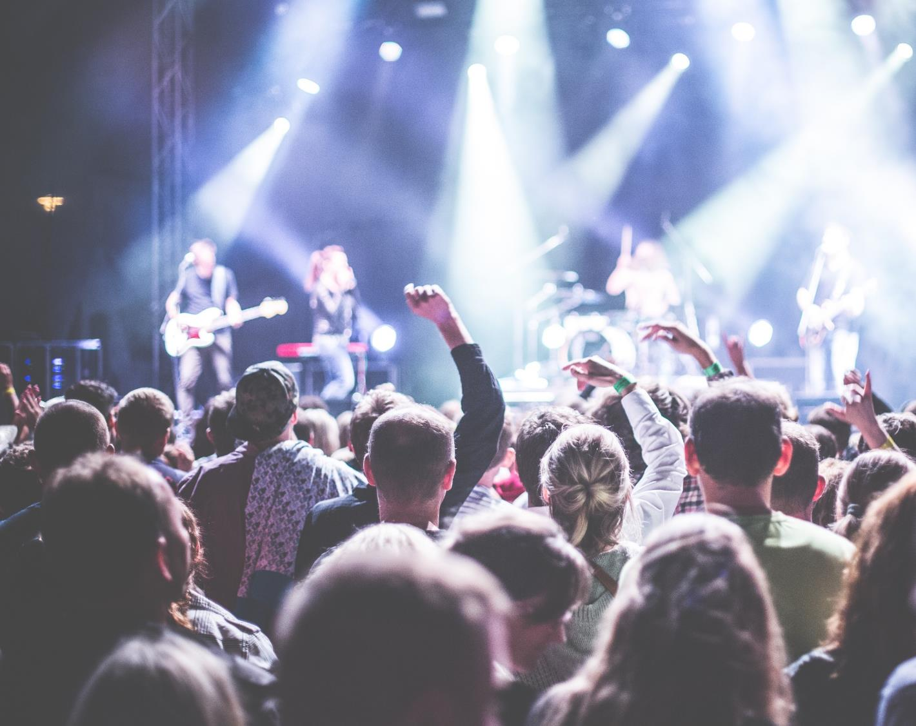
Identifying gatherings
Identifying hot spot zones or large crowd gather, and where social distancing is not observed
Notes:
Script by the Phil educator:
For example, let's say we want to identify hot spots or zones where large crowds gather where there's new people aren't social distancing. One way to do that would be to have a GPS tracker on people and to know who they're associating with and where they're going. But that raises obvious privacy concerns emerged from your activity.
Image Source: Photo by picjumbo.com from Pexels (https://www.pexels.com/photo/crowd-in-front-of-people-playing-musical-instrument-during-nighttime-196652/)

Slide 16
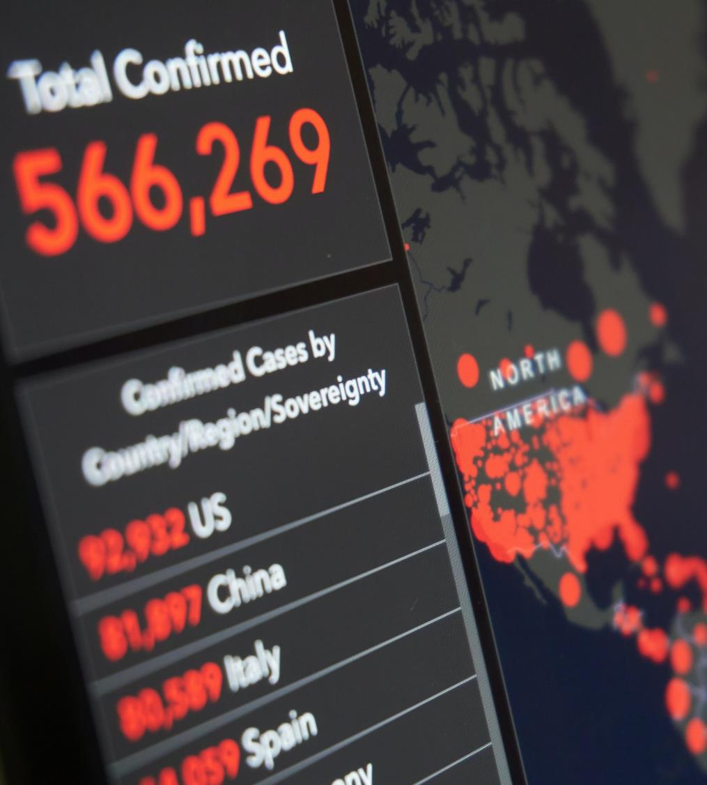
Infected areas
Identifying areas frequented by more COVID-19
Notes:
Script by the Phil educator:
Again, if you want identify areas frequented by more people with COVID-19, identify hotspots, we might need to know where people live and where they work, and that's another thing that might involve private information as it may leak other information
Image Source: Photo by Anton Uniqueton from Pexels (https://www.pexels.com/photo/global-coronavirus-map-with-country-statistics-4021262/)

Slide 17
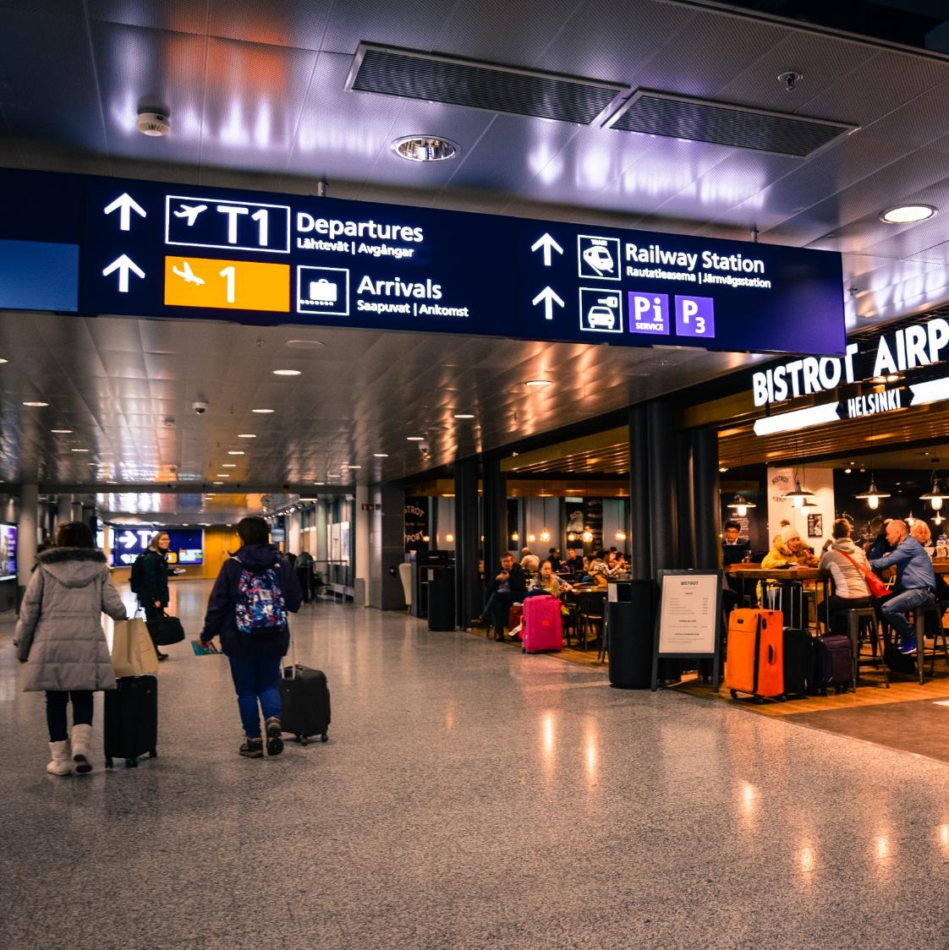
Identifying super spreaders
Identifying people who travelled and thus are potential super spreaders to prioritize for rapid COVID-19 testing
Notes:
Script by the Phil educator:
We want to prioritize people who have traveled and are thus potential super spreaders for rapid testing but of course knowing who's leaving the country and where they're going and when they're returning, involves access to data that many people may prefer to keep private.
Image Source: https://www.pexels.com/photo/people-inside-airport-804463/ (https://www.pexels.com/photo/people-inside-airport-804463/)

Slide 18
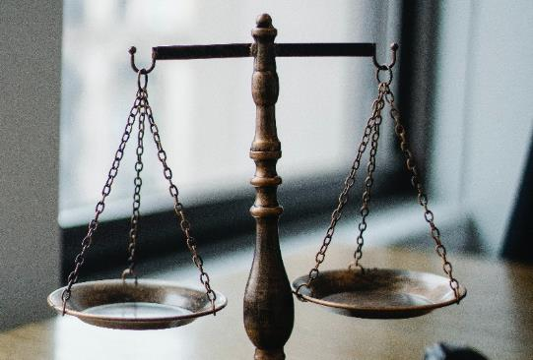
Inevitable trade-offs
Sometimes we may be able to find a way to get both the privacy and public health we want
But often, trade-offs will be inevitable--and different stakeholders will want different trade-offs
Notes:
Script by the Phil educator:
Sometimes we may be able to get everything we want. For example, we get all the privacy and the public health benefits together, but often that won't be possible. Even if we all agree that both privacy and stopping COVID-19 is very valuable; we're not necessarily disagreeing on what's valuable here, but we disagree on what kind of priority to put on each of these two values; how to trade them off against each other and importantly, different stakeholders will want different trade-offs. So, the difficulty isn't just deciding the right trade-off, it's figuring out what to do with the disagreement over the correct trade-off to make. So, the stakeholders you saw in your pre-watch video are all the people affected by the decision and in the COVID case, that's going to be a huge range of people: Everyone who might get COVID. Basically, that's everyone and everyone who might download the app, which is a huge swath of people are going to be potentially affected by this, and they're all going to have potentially different trade-offs. So, now we're going to look at how can we identify some of these preferences over trade-offs. Figure out what kind of trade off a stakeholder might want.
Image Source: Photo by Sora Shimazaki from Pexels (https://www.pexels.com/photo/judgement-scale-and-gavel-in-judge-office-5669602/)

Slide 19
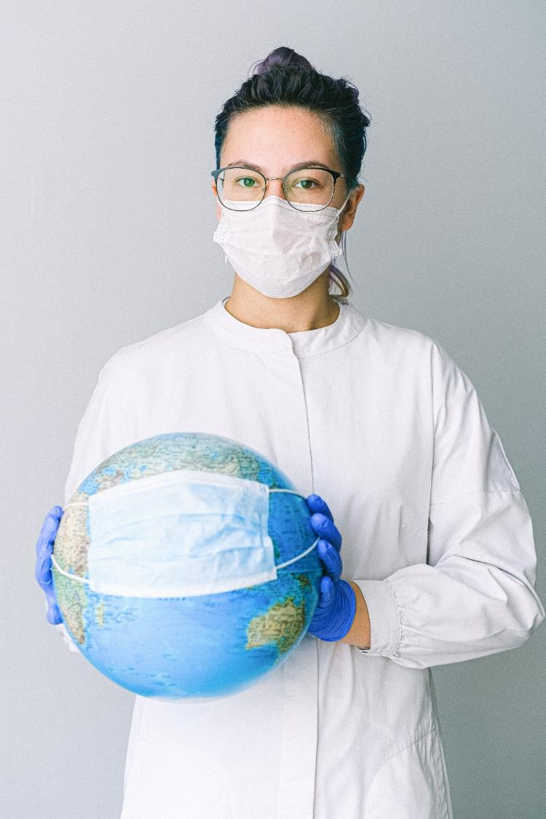
Sahar: A public health official
Sahar is a public health official. Her main aim is to stop the spread of the virus. She wants an app that collects enough information to allow for effective contact tracing, but also protects the user’s privacy enough that the app will be widely downloaded and used.
Notes:
Script by all educators:
The best way would be to ask the stake holders, but when there's so many stakeholders, we can't ask everyone, so we need to be able to look at their situation and figure out what they might want. Let's look at Sahar who is a public health official and her main aim which is to stop the spread of the virus. So, she wants an app that collects enough information to allow for effective contact racing, but also protects users’ privacy enough so, the app will be widely downloaded and used.
<Conversation between the educators>
-What do you think Sahar’s preference would be for the trade-off between public health and privacy?
-Well, I think that this is a hard decision because on one hand she wants to take care of her patients; so, the more data the better. On the other hand, there is the issue of trust because those data are sensitive and can be used in different ways. She wants to protect the patients’ privacy and have them trust her so that she can do her job better.
-It sounds like since her reason for valuing privacy is in order to get this public health goal, she's going to care about both. But she's going to be prioritized public health, because that's kind of the basis of her both for her wanting this app to collect data and her wanting to protect privacy. So that's probably the one that she needs a little more heavily.
So, this is kind of an example of how we can talk about a particular case. Notice there's a couple of steps here that are important. One is we identify what we think as a conclusion should be, what trade-off do you think she's going to prefer leaning one way? Meaning which is going to be more important. But we also look at particular things about her situation to explain that preference. We're now linking this feature of her background with her caring what users’ privacy to the particular trade-off she would prefer.
Image Source: Photo by Anna Shvets from Pexels (https://www.pexels.com/photo/photo-of-person-wearing-protective-wear-while-holding-globe-4167541/)

Slide 20
Breakout room activity 2
(10 minutes)
Discuss with your teams any concerns that the stakeholder might have about a contact tracing app. Make sure to answer these three questions:
Do you think your assigned stakeholder would be more concerned about privacy or public health?
What details about their situation make you think they’d take this stance?
How do these details about your stakeholder’s situation explain their priorities?
Notes:
Script by the Phil educator:
So that brings us to our second breakout room activity. We're going to put you into breakout rooms. Teams are going to look at the philosophy worksheet and it's going to give you a description of stakeholders and your job is to answer these three questions:
Do you think your assigned stakeholder would be more concerned about privacy or public health? Why?
What details about the situation make you think they take this stand?
and
How do those details about your stakeholders’ situation explain their priorities? What is it about that feature you identified shows why they have the preference here?
Obviously, you can't know for sure, so we're going to have to take some reasonable assumptions here. If you feel comfortable doing so, I'd ask you to turn on your cameras to allow a bit more back and forth. If you can't do that, or you really don't want to, that's fine, but I'd encourage you to do so. Everyone jump into your breakouts, and we'll circulate around and see how you're doing and if you have any questions.
<Sample discussion, varies depending on the answers>
So, let's discuss the answers people came up with. I'll start with the example of Mike. Mike was an international student without a work permit. He's working illegally as a dog walker. He is sometimes in contact with people and somewhat likely to be exposed, but he's worrying if the contact Tracing app shares information, his illegal work could be revealed, and he'll be deported and loses healthcare and won't be able to complete this degree. So, where do we put him on this scale? Looks like the group we have put him all the way over on the valuing privacy scale. Does anyone from the group want say why?
-The deportation has devastating consequences and maybe they aren't as afraid of COVID at that age.
Yes, He might care less about covid, since he is an international student. As an international student, he's probably a younger person, so he's probably less likely to suffer severe complications.
Surge is a banker from Orthodox Catholic family that strongly disapproves of homosexuality. Surge is gay and hasn't revealed this fact to his family. So, he’s worried that he'd be shunned if they knew this about him. He visits his boyfriend Isaac, and he worries of his contracts or locations revealed, he'd be outed to his family. However, he's also worried about exposing his boyfriend to virus, since Isaac has a chronic illness and is at high risk.
We got some different views on this. Some people lean towards privacy, some people think he'd be sort of in the middle and more in favor of public health over privacy. Let's see why. So, the common entries to write the idea being well, unlike Mike who only have to worry about himself and is maybe not so concerned public health because he's not high-risk, Surge has someone he loves who is at high risk. So, he has this extra incentive to care about preventing the virus. But there is the chance that Surge himself gets covid passes it to Isaac. It's kind of speculative, whereas the concern that he gets outed is sort of maybe more vivid to him. On the other hand, he might care more about keeping his boyfriend Isaac safe. So maybe he's willing to take the risk, since after all, again, it's not certain his sexuality would be revealed if the app doesn't protect privacy information, so maybe he'd think that the risk to his boyfriend is more. All of these are defensible interpretations of the case, shows how difficult it can be.
Afet volunteers with homeless, she's deeply troubled by companies buying and using people's personal data for goals she disapproves of, and she's concerned about a contact tracing app tracking and storing data for unknown future purposes. We had a big spread here with a slight preference on privacy slightly. One reason to think is maybe she's more on the privacy side because she cares about people and their privacy. The homeless population may develop severe cases of COVID-19. They're also potentially vulnerable to privacy violations. They may have more to lose because there may be targeted by police or by other sources. So, they may worry about being discriminated against in various ways. So, maybe she's more concerned about privacy overall, and that's a reason to put her there.
Image Source: Photo by RF._.studio from Pexels (https://www.pexels.com/photo/photo-of-women-at-the-meeting-3810792/)

Slide 21
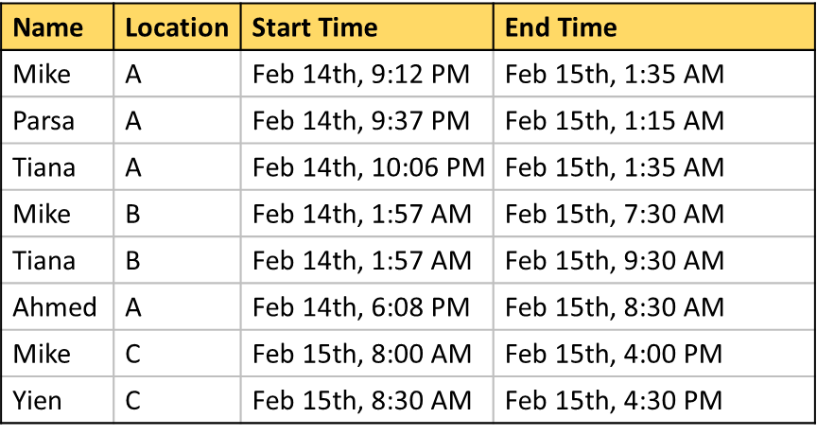
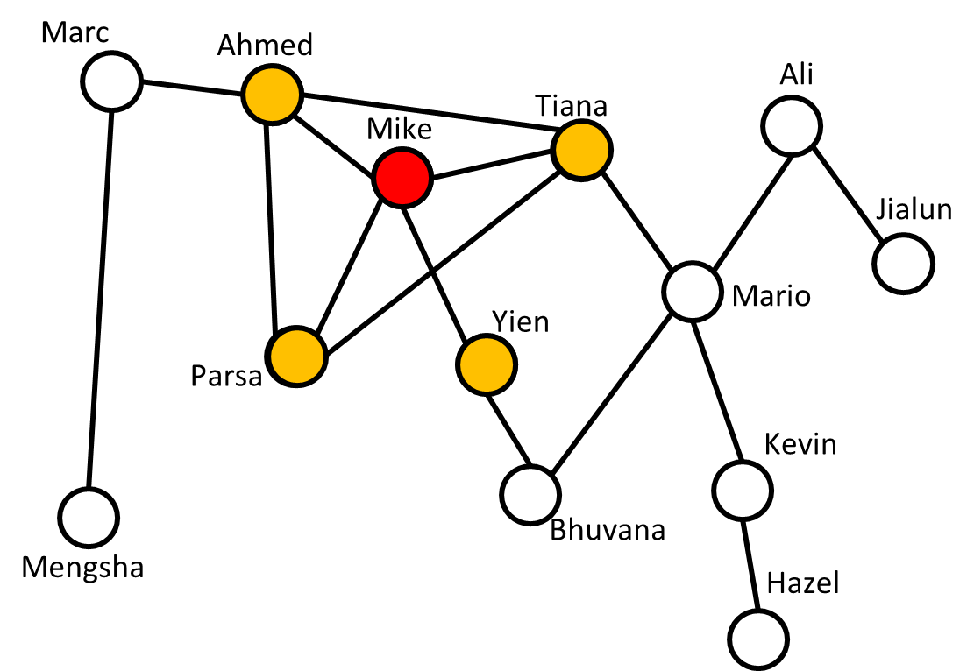
Addressing the ethical issues
Could we have collected less or different information and still accomplished the task of contact tracing?
How could we have changed what information we collect to minimize the potential for inference of further information?
Notes:
Script by the CS educator:
OK, now that we know why privacy is important, lets think about how we can improve our system, so it preserves privacy and still accomplishes the contact tracing goals. What are your thoughts?
In-class discussion, goal: Getting some ideas from students for possible solutions. If it does not come up, I will mention anonymizing.
These are all great answers. So now we leave you with these two questions. <questions are read from the slide>Think about them until we talk about …(Next slide)

Slide 22
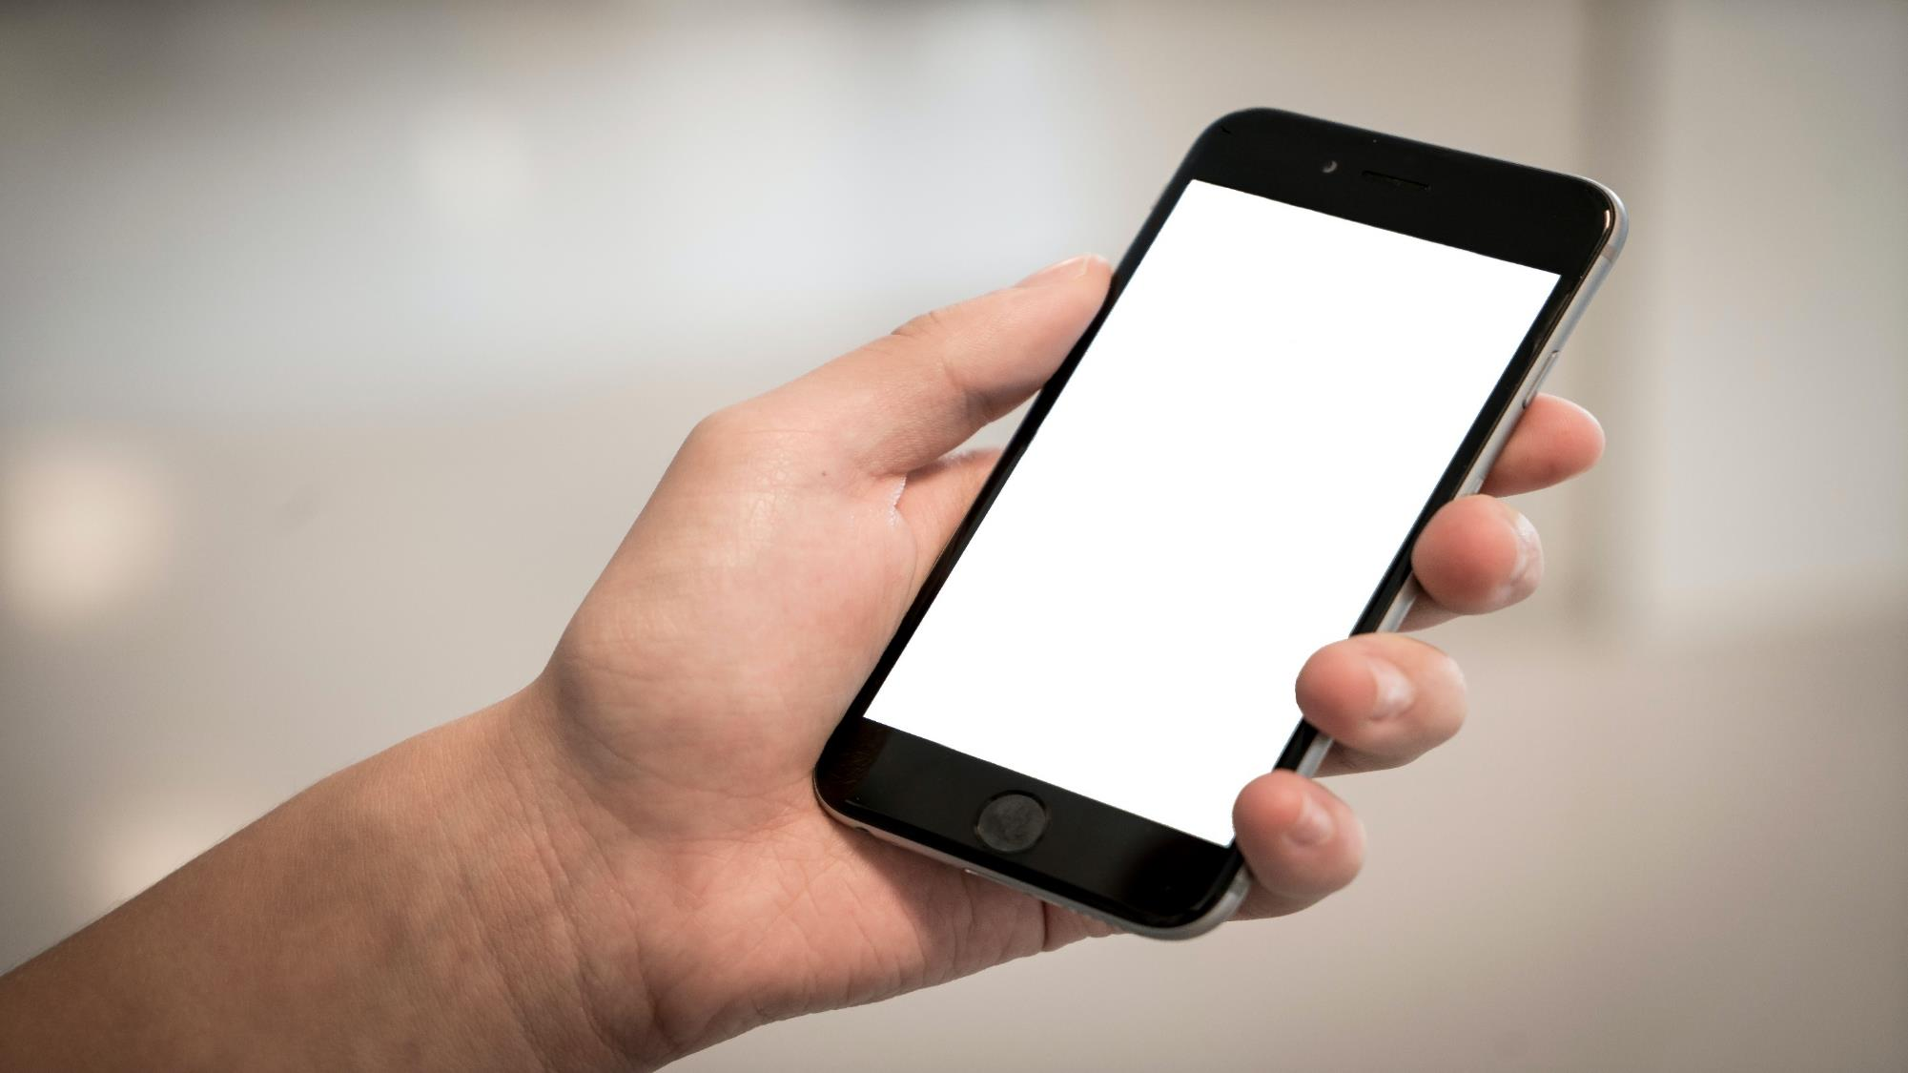
A better approach:
Exposure notification system
and Trade-offs
Next module…
Notes:
Script by the CS educator:
(continue from last slide ) … a better approach, exposure notification systems and trade-offs between preserving privacy and the system’s capabilities in the next module. Thank you everyone…(Next slide)
Image Source: Photo by Terje Sollie from Pexels (https://www.pexels.com/photo/selective-focus-photography-of-person-holding-iphone-displaying-white-screen-336948/)

Slide 23
Acknowledgements
This module was created as part of an Embedded Ethics pilot project through a joint initiative between the ¹Department of Computer Science and the ²Schwartz Reisman Institute for Technology and Society, University of Toronto.
Instructional Team:
Maryam Majedi¹, Emma McClure², Benjamin Wald²
Faculty Advisors:
Diane Horton¹ and Sheila McIlraith^{1,2}

Slide 24
References
[1] https://www.who.int/emergencies/diseases/novel-coronavirus-2019/events-as-they-happen
[2] World Health Organization. Contact tracing in the context of COVID-19. (Interim Guidance) ( 10 May 2020, https://www.who.int/publicationsdetail/contact-tracing-in-the-context-of-covid-19)
[3] https://www.hhs.gov/hipaa/for-professionals/privacy/special-topics/de-identification/index.html

